Slide 1
Software Engineering
Chapter 5: Software Design -
Unified Modelling Language
Dynamic Aspects (State Diagrams & Sequence Diagrams
Learning Outcomes
  Be able to model the dynamic nature of a system
  Be able to draw state diagrams
  Be able to draw sequence diagrams

Slide 2
Dynamic Modelling
The dynamic model represents control
information; the sequences of events, states
and operations that occur within a system of
objects, usually involving the time dimension.

Slide 3
Events, States and Activities
State Diagrams chart the life-span of an object from creation to destruction and the discrete (finite) states in-between
Event
  something that happens at a point in time. An event has no duration. For example, received messages, time-outs, error exceptions.
State
  an abstraction of the attribute values and links of an object
Activity
  an operation that takes time to perform
  closely associated with a state
Action
  an operation performed on a state change

Slide 4
State Diagram - Notation
name of
event which
causes transition
an action that is
performed when
the event occurs
a pre-condition before
a transition occurs
State 1
do/activity 1
event [condition] /action
State 2
. . .
Finish State
Starting point

Slide 5
Example State Diagram
Invoice created
Unpaid
Paying
Paid
Invoice destroyed

Slide 6
Relationship between State Diagram and Class Diagram
A state diagram relates to ONE class within a class diagram. The received events are often messages that will have originated at one of the other classes with which the class in question has a relationship.
Events are basically received messages and are therefore handled by a receiving class operation.
Actions - happening upon a state transition - are usually class operations that may result in a message being sent to another object.
Activities - happening within a particular class state - are usually class operations.

Slide 7
A State Diagram
Alarm System
Monitor
do/ check
detectors
Detected
do/ ring bell
flash lights
Intruder alert/
phone police
Passive
access code typed in
[30 seconds passed]
correct access code typed in

Slide 8
Another Example - Digital Watch
A simple digital watch has a display and two buttons to set it, the A
button and the B button. The watch has two modes of operation,
display time and set time.
In the display time mode, hours and minutes are displayed.
The set time mode has two sub modes: set hours and set minutes.
The A button is used to select modes. Each time it is pressed, it
advances through the modes: display, set hours, set minutes, display
...etc. Within the sub modes, pressing B will advance the hours or
minutes each time it is pressed. Buttons must be released before they
generate another event.
Create a state diagram for the watch.

Slide 9
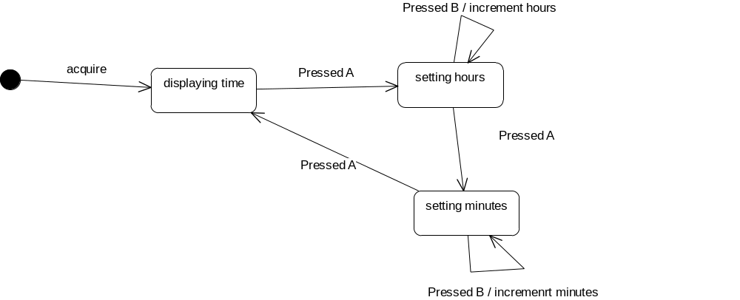
Possible solution - State Diagram
Do:Flash hours
Do:Flash minutes

Slide 10
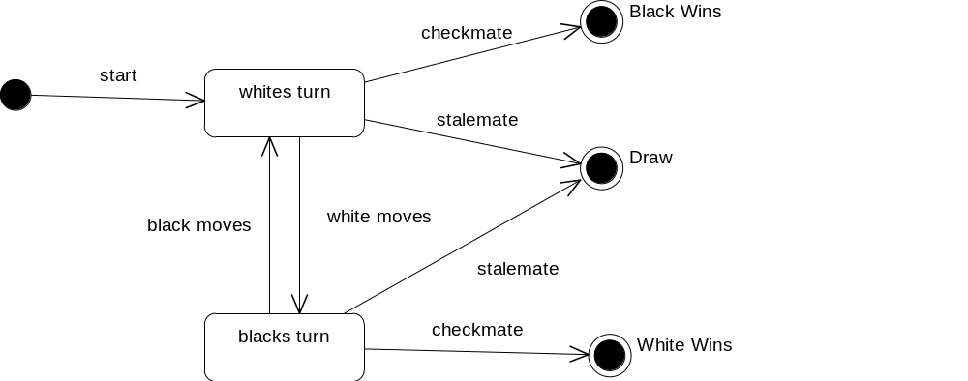

Slide 11
Summary
All systems have a static and dynamic behaviour
The static structure can be described using class models
The behaviour describes how the elements within the structure interact over time
The state diagram describes the behaviour of and the internal states within a class, focusing on how objects over time change their states, depending on events that occur, the actions and when transitions occur

Slide 12
Sequence Diagrams - essentials
Sequence Diagrams illustrate how objects (and actors) interact with each other - used to describe scenarios
Objects communicate using messages
  messages are communications between objects that convey information with the expectation that something will happen
Sequence diagrams have 2 axes
  objects along the horizontal axis
  lifeline (time) down the vertical axis
  messages represented by arrows
objects
message
lifeline
(time)

Slide 13
e.g. Ordering system
Partial Class Diagram
Order
OrderLine
ReOrderItem
orderNumber
date
etc…
itemnumber
quantity
etc…
itemnumber
quantity
etc…
prepare()
check(): boolean
remove()
StockItem
DeliveryItem
orderNumber
minQuantity
date
etc…
is_for
deliveryadress
quantity
etc…
needsToReorder(): boolean

Slide 14
Sequence diagram example
anOrder Entry window
anOrder
anOrder Line
aStock Item
prepare()
* prepare()
check()
[check=“true”] remove()
needsToReorder()
[needsToReorder=“true”]
new
AReorder Item
[check=“true”] new
aDelivery Item

Slide 15
Sequence diagram example
anOrder
Object - we may also state this with its class name
anOrder: Order
Arguments go in here
prepare()
* prepare()
Iteration - sent many times to multiple receiver objects
needsToReorder()
Self Delegation - an object sends a message to itself
[check=“true”] remove()
A conditional message (only sent if condition is true)

Slide 16
Sequence Diagrams - another example
accesses
Computer
PrintServer
Printer
status(): integer
uses
print(file)
print(filename)
print(file)
Managed by
Queue
store(file)

Slide 17
Sequence Diagrams - another example
aComputer: Computer
aPrintServer:
PrintServer
aPrinter:
Printer
aQueue:
Queue
aUser: User
print
(filename)
print(file)
[printer free] print(file)
[printer busy] store(file)

